Slide 1

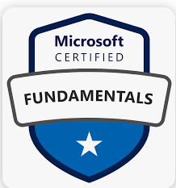
Azure Fundamentals (AZ-900)

Slide 2

Day -2 Azure Architecture and Services

Slide 3
Outlines
Introduction to Microsoft Azure
Azure Subscription
Azure Global Infrastructure
Azure Physical Infrastructure
Azure Management Infrastructure
Azure Compute Services

Slide 4
Introduction to Azure
Azure is a cloud computing platform from Microsoft.
Expanding set of services to help you build solutions to meet your business goals.
Provides a broad range of cloud services
Example: Compute, Database, storage, Networking and Analytics...etc.
Azure supports open-source technologies
Azure offering free Azure suscriptions
Azure provide Good Security , Availability and Scalability
Azure Globally having 60 + Régions with 160 + Data centers
Notes:
https://azure.microsoft.com/en-in/free/

Slide 5
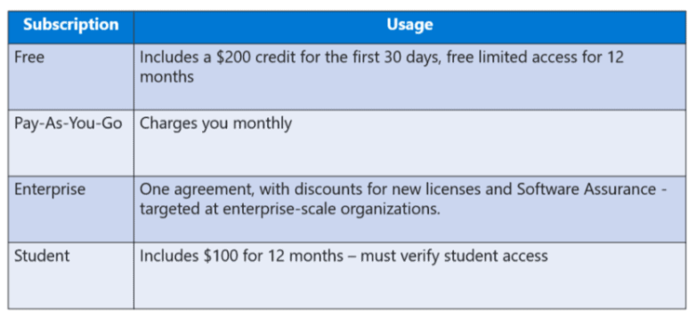
Subscription Types

Slide 6
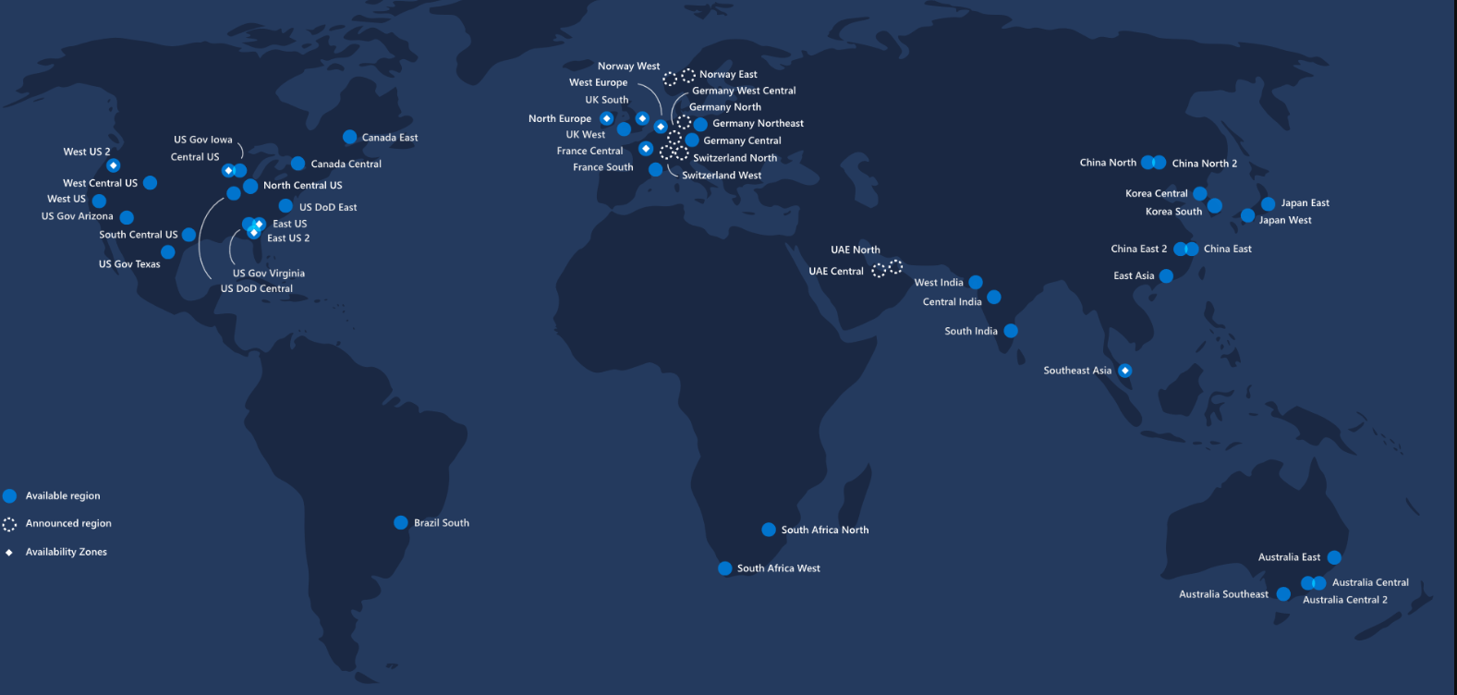
Azure Global Infrastructure
Azure is generally available in 54 regions around the world, with plans announced for 8 additional regions.

Slide 7
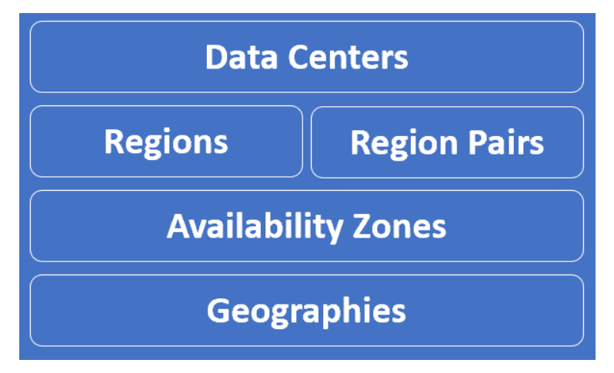
Azure Data Centers
To understand Azure better, we need to understand Azure global infrastructure specific terms like

Slide 8
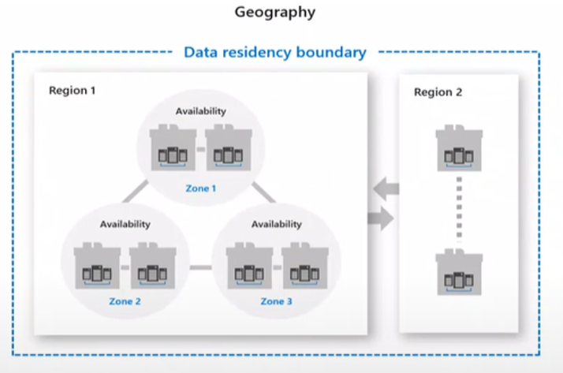
Azure Physical Infrastructure
Geography
An Azure geography is an area of the world that contains at least one Azure region. For example, India is a geography. Similarly United States and United Kingdom are geographies.
Why are Azure Geographies important
Legally your organization is required to store such data in the same country where the operations are being carried out.

Slide 9
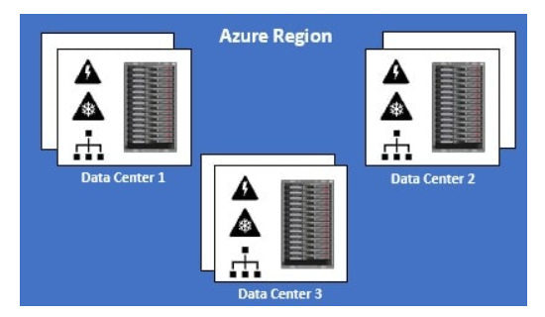
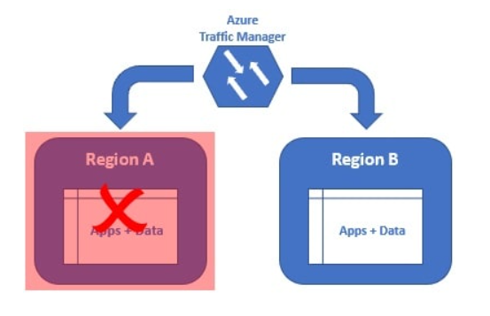
What is an Azure Region
Azure Region is a set of Datacenters that are connected through a dedicated low-latency network.
A Region could be made up of just 1 datacenter or multiple datacenters
Azure has 58 regions worldwide.
What is cross-region resiliency

Slide 10
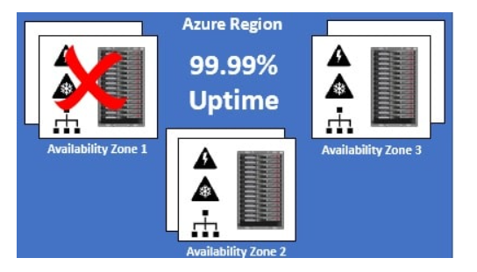
Azure Availability Zone
An Azure Availability Zone is a unique physical location within an Azure region.
Each Availability Zone is made up of one or more datacenters with independent power, cooling, and networking.
Not all Regions have Availability Zones.
Regions that support Availability Zones have a minimum of three separate zones to ensure resiliency
An Availability Zone is a combination of a fault domain and an update domain.

Slide 11
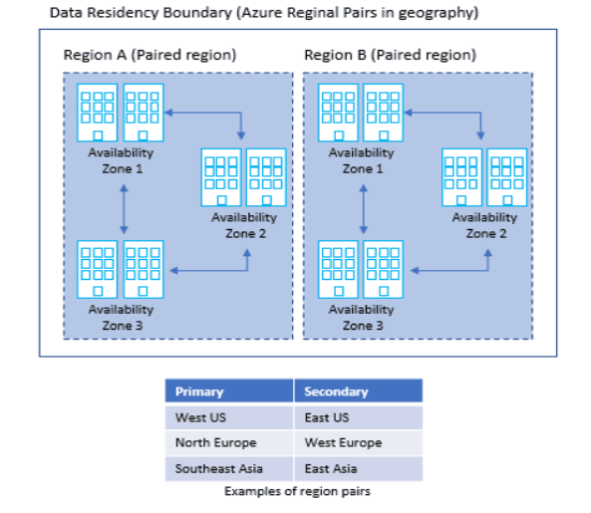
Region Pair
Each Azure region pairs with another region within the same geography, together making a regional pair.
Azure Regions in a Pair have direct connections that bring additional benefits to use them together.
Each Azure Region in a pair is always located greater than 300 miles apart when possible.

Slide 12
Sovereign Regions
Dedicated to specific sovereign entities
Ex: Azure Government - US, Azure China..Etc.
Azure Government
We also have a geography called Azure Government. This geography is only available to the United States federal, state, local, and tribal governments and their partners. It's not available for general public use.

Slide 13
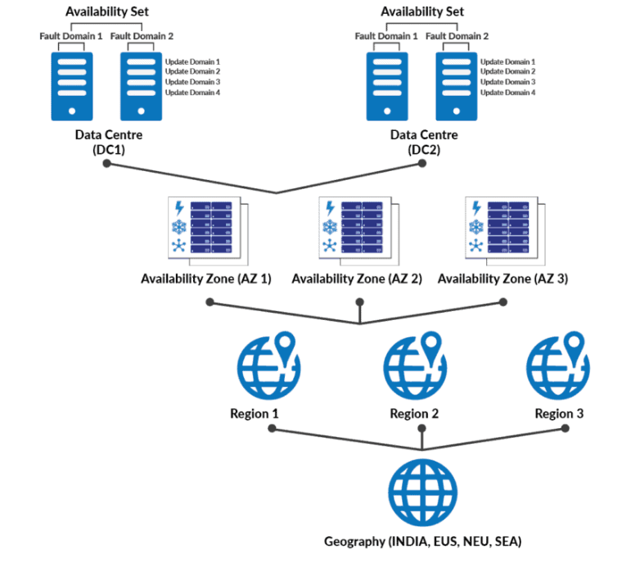
Azure Architecture
Notes:
https://www.youtube.com/watch?v=ItZBNyutDQo&ab_channel=K21Academy

Slide 14
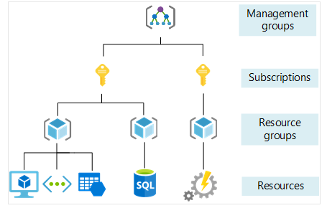
Azure Management Infrastructure
Management groups : Manage costs for resources provisioned for different teams or projects or different business units
Subscriptions : Manage costs for resources provisioned for different teams or projects or different business units
Resource groups : logical containers where you can deploy and manage Azure resources like web apps, databases, and storage accounts.
Resource : instances of services that you can create, such as virtual machines, storage, and SQL databases.
Notes:
https://www.pragimtech.com/blog/azure/azure-management-groups-and-subscriptions/
Management group is at the top of the hierarchy. All subscriptions in a management group automatically inherit the conditions or settings specified at the management group level. So, a management group is like a container for all your subscriptions. Just like how there can be multiple subscriptions, there can also be multiple management groups in an organisation.

Slide 15
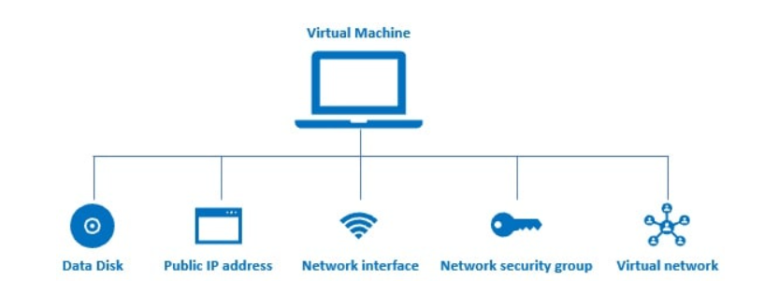
Benefits of Azure Resource Groups
Administration is much easier
Cost management is easier
Role-based access control (RBAC)

Slide 16
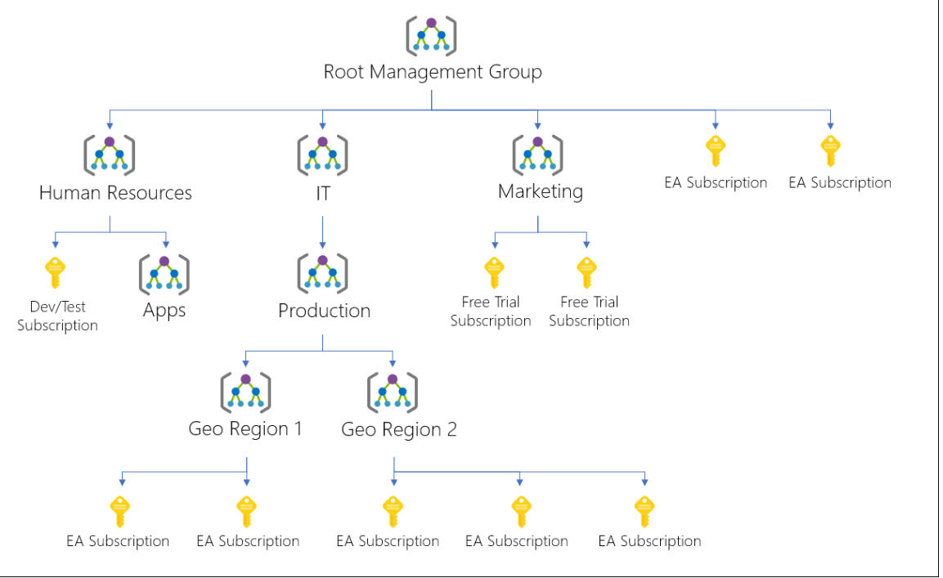
Management Group
Management group is at the top of the hierarchy.
All subscriptions in a management group automatically inherit the conditions or settings specified at the management group level.
Management group is like a container for all your subscriptions.

Slide 17
LAB Sessions

Slide 18
Azure Compute Service
Virtual Machines
Virtual Machine Scale Sets
Virtual Machine Availability set
Container Instances (ACI)
App Services
Functions
Notes:
https://www.youtube.com/watch?v=5NMcM4zJPM4

Slide 19
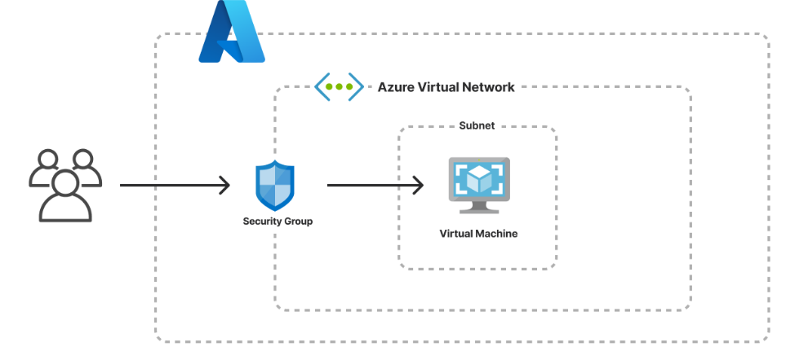
Virtual Machine
Azure Virtual Machines are image service instances that provide on-demand and scalable computing resources with usage-based pricing.
Each Virtual machine provides its own virtual hardware including CPUs, memory, hard drives, network interfaces and other devices.
Each Virtual Machine offers the flexibility of virtualization without buying and maintaining the physical hardware that runs it.
Notes:
An Azure VM gives you the flexibility of virtualization without having to buy and maintain the physical hardware that runs the VM. However, as an IaaS offering, you still need to configure, update, and maintain the software that runs on the VM.
An image is a template used to create a VM and may already include an OS and other software, like development tools or web hosting environments.

Slide 20
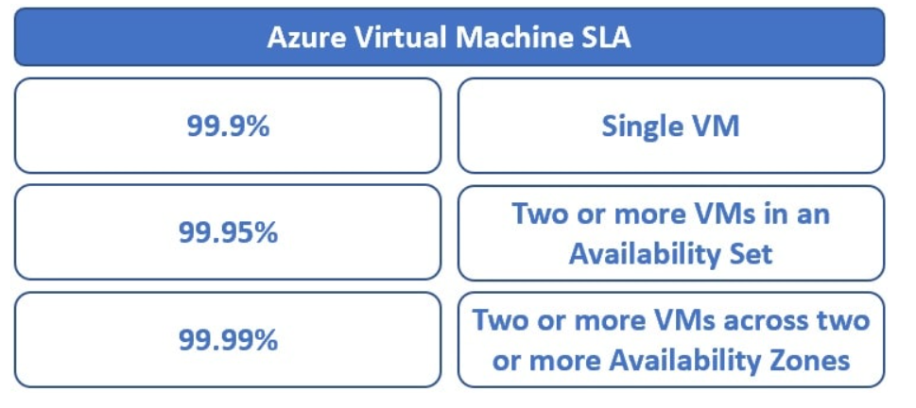
VM SLA

Slide 21
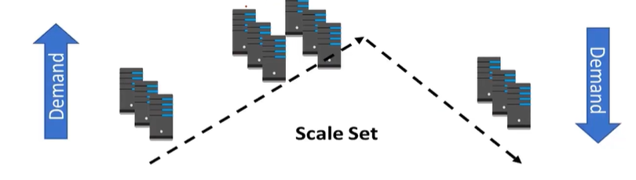
Virtual Machine Scale sets
Scale sets deploy a set of identical VMs
No pre-provisioning of VMs is required
As demand goes up VMs are add
AS demand goes down VMs are removed
The process can be manual, automated, or a combination of both.
Notes:
How do you simplify creation and management of multiple VMs?
Ex: Enter VM scale sets
Provides high availability to your applications
Distribute VM instances across Multiple AZs
Supports Manual Scaling and Auto Scaling
Supports upto 1,000 VM instances
You can run single VMs for testing, development, or minor tasks. Or you can group VMs together to provide high availability, scalability, and redundancy. Azure can also manage the grouping of VMs for you with features such as scale sets and availability sets.
The number of VM instances can automatically increase or decrease in response to demand, or you can set it to scale based on a defined schedule. Virtual machine scale sets also automatically deploy a load balancer to make sure that your resources are being used efficiently. With virtual machine scale sets, you can build large-scale services for areas such as compute, big data, and container workloads.

Slide 22
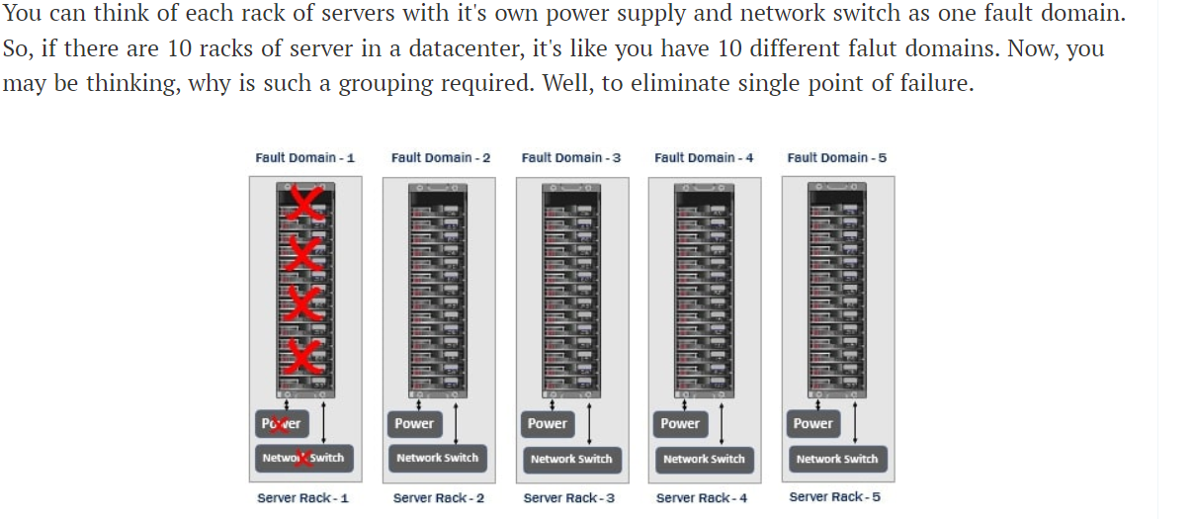
Availability Set
The servers in a datacenter are divided into multiple physical and logical groups. The physical grouping is called fault domain and the logical grouping is called update domain.

Slide 23
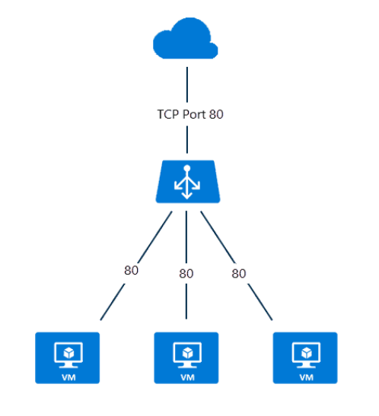
Load Balancer
Distribute traffic to your backend virtual machines.
An Azure load balancer provides high availability for your application.
Can create 2 types of the load balancer in Azure.
1. Public load balancer
2. Internal / private load balancer
Notes:
https://k21academy.com/az-305/azure-load-balancer-step-by-step/
A public load balancer can be used to load balance internet traffic to virtual machines. It can provide outbound connections for virtual machines (VMs) inside your virtual network.
An internal (or private) load balancer is used to balance traffic from within a virtual network.

Slide 24
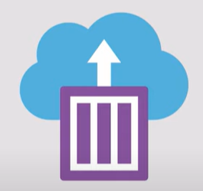
Azure Container Instance (ACI)
Azure Container Instances (ACI) is a service that enables a developer to deploy containers on the Microsoft Azure public cloud without having to provision or manage any underlying infrastructure.
The service supports both Linux containers and Windows containers.
It eliminates the need for a developer to provision virtual machines (VMs) or implement a container orchestration platform, such as Kubernetes, to deploy and run containers.
Notes:
https://www.youtube.com/watch?v=jAWLQFi4USk&ab_channel=AdamMarczak-AzureforEveryone
https://www.techtarget.com/searchcloudcomputing/definition/Azure-Container-Instances
Manage and run simple container based applications
You do not need to provision and manage VMS
Start containers in seconds
Azure app service also supports deploying simple containers
Easily deploy the applications into Azure containers

Slide 25
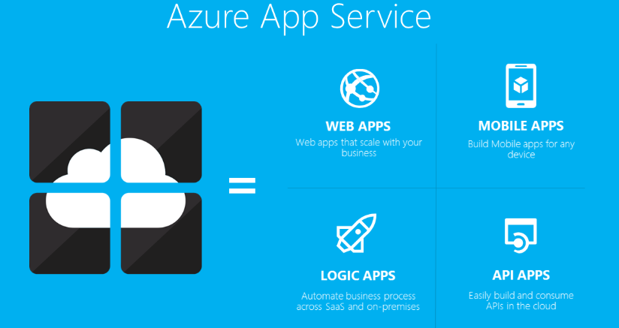
App Services
We use it to host backend services for mobile applications, REST APIs, and web applications.
App Service is type of PaaS

Slide 26
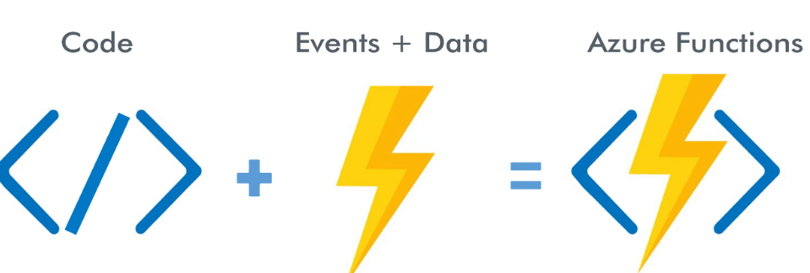
Azure Functions
It is a serverless compute service that lets you run event-triggered code without having to explicitly provision or manage infrastructure.
Azure Functions allows you to run small pieces of code (called "functions") without worrying about application infrastructure.
Notes:
https://www.youtube.com/watch?v=eS5GJkI69Qg&ab_channel=WafaStudies
What do we think about whne we develop an application ?
Where to deploy ? what kind of server ? What OS?
How do we take care of scaling and availability of the application?
What if you don't need to worry about servers and focus on your code?
Enter serverless
Remember : serverless does not mean "No servers"
You don't worry about infrastructure
Flexible scaling and automated high availability
Most important : Pay for use
Ideally Zero request ==> Zero cose
You focus on code and the cloud managed service takes care of all that is
needed to scale your code to server millions of request
Pay for requests and not servers

Slide 27
Quiz Time

Slide 28
Q
A

